Slide 1
A Clustering Approach for Personalizing Diversity in Collaborative Recommender Systems
Farzad Eskandanian, Bamshad Mobasher, Robin Burke
Center for Web Intelligence
DePaul University
feskanda@depaul.edu, mobasher@cs.depaul.edu, rburke@cs.depaul.edu

Slide 2
1 Introduction
From the beginning, much of the attention in recommender systems research has been devoted to generating accurate recommendations.
But, focusing only on accuracy as an objective may prevent recommender systems from taking the risk of recommending items that are different from those seen by user in the past——May lead to monotony.

Slide 3
1 Introduction
recommending too many similar or redundant items are well-known drawbacks of many of the traditional recommendation algorithms.
In recent years other criteria beyond accuracy, such as diversity and novelty of recommendations, have been studied as important factors.
In our context, diversity refers to the distribution of categories, genres, or topical areas with a recommended list of items.

Slide 4
1 Introduction
Early work in information retrieval, for instance, has involved re-ranking the search results in a way that would increase the topic diversity of the top results.
Marginal relevance is defined as a linear combination of relevance (to the query) and dissimilarity of retrieved documents in the search results.
Other approaches have tried to incorporate the notion of diversity into the learning to rank process

Slide 5
1 Introduction
However, many of these methods generally assume that the user’s preference or tolerance for diversity is constant across all users.
Any attempt to increase the diversity of recommendations in a uniform way for all users will result in poor recommendations for the first user.
In other words, recommender systems need not only personalize the recommendation lists based on users’ preferences or tastes, but also personalize the degree of diversity in the recommendation lists.

Slide 6
1 Introduction
We are proposing a pre-filtering approach to personalize diversity by automatically segmenting the users based on their preferences on the predefined categories (topics, genres, etc.) associated with items.
We then employ a user-based collaborative filtering approach to compare the recommendations in the general population (without diversity-based segmentation) with those obtained for each segment separately.

Slide 7
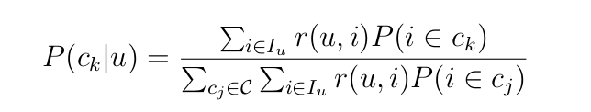
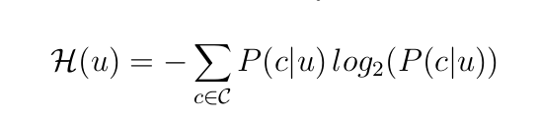
2 Measuring Diversity
Using ratings in user profile I u , we can define the likelihood of the interest of user u in category c k by:
To measure the degree of tolerance for diversity for a user u we use the Shannon entropy:

Slide 8
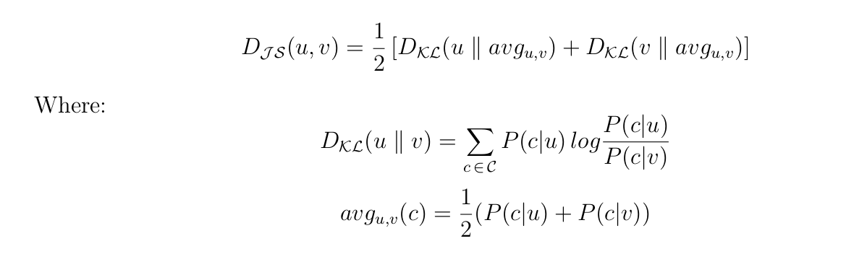
3 Clustering user profiles
K-Medoids is a partition-based clustering that uses the pair-wise distance of data points like K-Means but instead of computing the mean centroids to minimize the within-cluster sum of distances it uses the data points themselves as centroids.
Therefore, in order to define the distributional similarities between categorical distributions of user profiles, we use Jensen-Shannon (symmetry and triangle inequality) divergence.

Slide 9
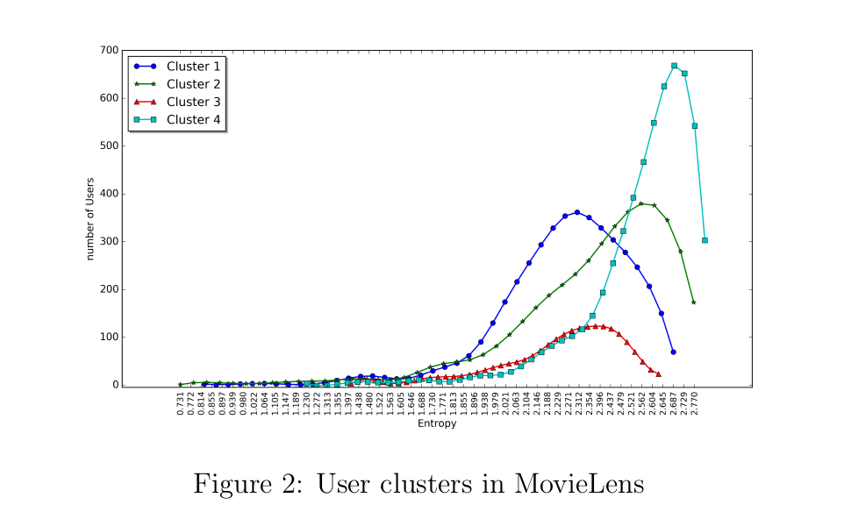
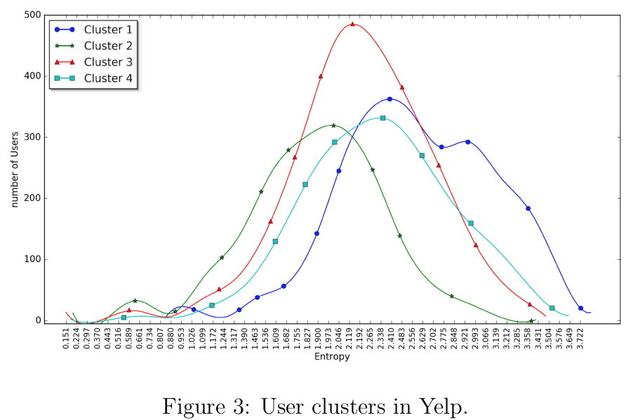
3 Clustering user profiles

Slide 10
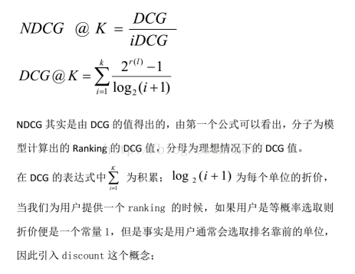
4 Evaluation
First, the standard NDCG metric is used to measure only the accuracy of recommendation list in terms of user’s preferences on recommended items.

Slide 11

4 Evaluation
NDCG IA, captures the degree of personalization of diversity in the recommendation list based on the user’s past tolerance for diversity.it also captures relevance of the results in terms of test items ranked in each category for each user.

Slide 12
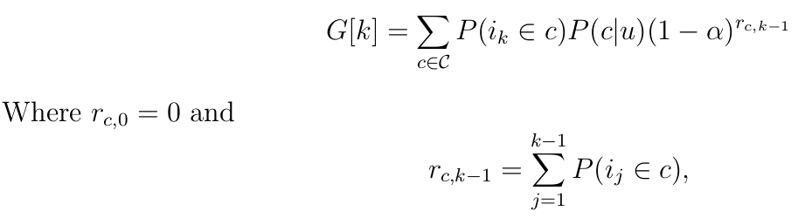
4 Evaluation
The third metric α-NDCG is used only for the purpose of measuring personalization in diversity, but not relevance of the results.

Slide 13
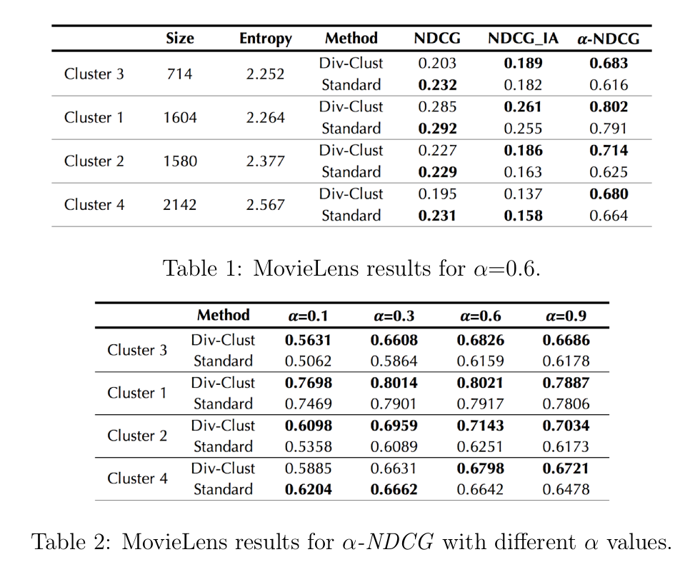
4 Evaluation

Slide 14
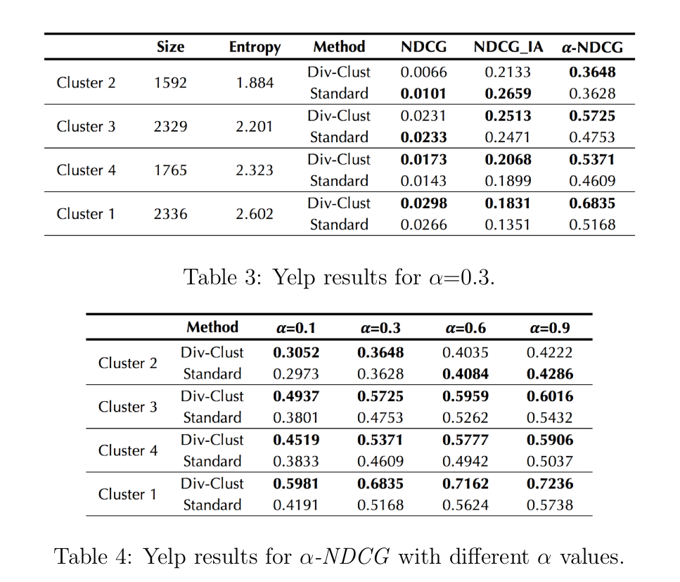
4 Evaluation

